Slide 1
DEEP LEARNING:DETECTION OF PNEUMONIA AND TUBERCULOSIS USING VISION MODEL

Slide 2
Introduction
Tuberculosis and Pneumonia detection using chest X-ray images represents a critical application in healthcare diagnostics .Multiple CNN architectures provide diverse feature extraction capabilities for medical image analysis .Traditional single-model approaches often fail to capture subtle variations in radiological patterns. Ensemble learning techniques combine strengths of various CNN models for enhanced diagnostic accuracy. Large-scale medical datasets like TBx11k and combined pneumonia datasets enable robust model training. Deep learning in radiology offers potential for automated screening and diagnostic assistance. This project develops an integrated system combining five state-of-the-art CNN architectures for chest X-ray classification

Slide 3
Aim
Develop a multi-model CNN ensemble system for enhanced TB and pneumonia detection accuracy.
Create an integrated prediction pipeline combining five different CNN architectures.
Build a user-friendly web interface using Gradio for easy medical image interaction and visualization.
Implement ensemble learning strategies to leverage strengths of individual CNN models.
Establish a comprehensive experimental framework for comparing single vs. multi-model performance

Slide 4
Objective
Design and implement five proven CNN architectures (VGG16, ResNet50, DenseNet121, InceptionV3, EfficientNetB3) for chest X-ray classification. Develop an ensemble mechanism that combines model predictions for improved diagnostic accuracy. Create an intuitive Gradio based medical GUI for seamless image upload and diagnosis visualization. Evaluate and compare clinical performance metrics between individual models and the ensemble approach

Slide 5
Literature survey -
Deep Residual Learning for Image Recognition
ResNet architecture introduced skip connections solving vanishing gradient problems in medical image analysis.Identity mapping shortcuts enable training very deep networks for complex radiological pattern recognition. Batch normalization combined with proper initialization allows effective deep network training. Medical imaging applications demonstrate ResNet's effectiveness in various diagnostic tasks.
Transfer learning capabilities show strong performance when adapted to chest X-ray datasets.ResNet50 achieves 92.7% accuracy in our TB/Pneumonia detection pipeline

Slide 6
Literature Survey -
Densely Connected Convolutional Networks
DenseNet architecture maximizes information flow between layers through dense connectivity. Feature reuse mechanism reduces parameters while maintaining high representation capacity. Gradient flow improvements enable robust training on complex medical imaging datasets. Memory efficiency critical for deployment in resource-constrained clinical environments. Medical imaging benchmarks show competitive performance across various diagnostic tasks. DenseNet121 achieves 85.9% accuracy with excellent normal case detection in our implementation

Slide 7
Literature Survey -
EfficientNet: Rethinking Model Scaling for Convolutional Neural Networks
Compound scaling method optimally balances depth, width, and resolution for medical imaging.Neural Architecture Search identifies efficient baseline architectures for diagnostic applications. Resource efficiency enables deployment on various clinical hardware configurations. Transfer learning optimization shows strong performance on medical datasets with limited samples. Clinical deployment suitability with balance between accuracy and computational requirements. EfficientNetB3 achieves 76.3% accuracy with superior AUC-ROC performance in our system

Slide 8
Literature Survey -
Medical Chest X-Ray Classification using Deep Learning
Chest X-ray datasets including ChestX-ray14, CheXpert provide benchmark for model evaluation. Multi-label classification approaches handle complex cases with multiple conditions. Class imbalance challenges addressed through specialized loss functions and sampling techniques. Clinical validation requirements for medical AI systems in diagnostic workflows. Ensemble approaches consistently outperform single models in medical imaging tasks. VGG16 baseline achieves 77.0% accuracy with room for improvement through ensemble methods

Slide 9
Research
Gap
Limited diversity: Most medical imaging studies focus on variants of single architecture families
Clinical deployment challenges: Few studies address real-world integration with existing radiology workflows
Diagnostic confidence metrics: Lack of comprehensive uncertainty quantification in multi-model systems
Cross-institutional validation: Limited testing across different healthcare facilities and patient populations
Real-time diagnostic requirements: Balancing computational efficiency with clinical accuracy in time-sensitive scenarios
Interpretability for radiologists: Need for explainable AI features to support clinical decision-making

Slide 10
Dataset
Combined Pneumonia Dataset (Hugging Face) for Pneumonia
Source: darthPanda/combined-unknown-pneumonia-and-tuberculosis
Total Images: 1,527 images in final training set
Image Resolution: High-resolution medical imaging format
TBx11k Dataset (Kaggle) for TB
Source: Large Scale Tuberculosis Dataset from Kaggle
Total Images: 11,200 chest X-ray images
Image Resolution: High-resolution medical imaging format
Annotation: Expert radiologist verified classifications

Slide 11
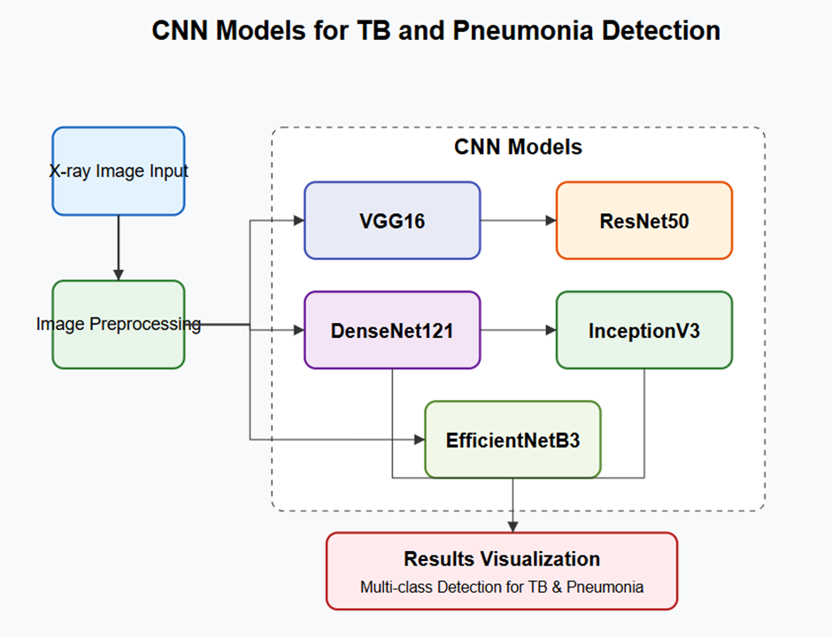
Architecture Diagram

Slide 12
Architecture Diagram
Architecture Components
1. Input Layer: Processes images from TBx11k and Combined datasets
2. Preprocessing: Medical-specific image standardization
3. CNN Models: Five parallel architectures with proven performance
4. Ensemble Fusion: Advanced combination techniques
5. Output Layer: Multi-class medical diagnosis
6. Interface: Clinical-grade Gradio implementation

Slide 13
Module Used
Training Modules
PyTorch: Primary deep learning framework for model development
OpenCV: Medical image processing and augmentation
scikit-learn: Performance metrics and evaluation tools
Pandas/NumPy: Dataset management and preprocessing
Matplotlib/Seaborn: Visualization of training metrics and results
Model Processing UI Modules
Gradio: Medical interface framework for healthcare professionals
PIL: Image processing for chest X-ray handling
NumPy: Numerical operations for medical data
Matplotlib: Medical visualization and plotting
Flask: Backend API for EMR integration
DICOM Library: Medical imaging standard compliance

Slide 14
Image Classification and Training
Dataset Integration: Combine TBx11k and pneumonia datasets
Preprocessing: Standardize images to 224x224, normalize pixels
Data Augmentation: Medical-specific transformations applied
Model Initialization: Load pre-trained weights for transfer learning
Fine-tuning: Adapt models to chest X-ray classification task
Training Loop: Forward pass, loss calculation, backpropagation
Validation: Monitor performance on held-out validation set
Ensemble Training: Train individual models with optimal hyperparameters
Fusion Strategy: Develop weighted voting based on validation performance
Final Evaluation: Test ensemble on held-out test dataset

Slide 15
CNN and Its Architecture
CNN Fundamentals
Convolutional Layers: Extract spatial features through learnable filters
Pooling Layers: Reduce spatial dimensions while preserving important features
Activation Functions: ReLU, LeakyReLU, Swish for non-linearity
Batch Normalization: Stabilize training and reduce internal covariate shift
Dropout: Regularization technique to prevent overfitting
Fully Connected Layers: Final feature mapping to classification output
Architecture-Specific Features
VGG16: Simple architecture with repeated 3x3 convolutions
ResNet50: Skip connections enabling deeper network training
DenseNet121: Dense connectivity for feature reuse and efficiency
InceptionV3: Multi-scale feature extraction through parallel paths
EfficientNet: Compound scaling for optimal depth/width/resolution balance

Slide 16
Processing of Models from Hugging Face
Hugging Face Integration Process
Model Repository: Direct access to pre-trained models via transformers library. AutoClass Loading Automatic model and tokenizer initialization.
Pre-trained Weights: Leverage models trained on massive datasets Fine-tuning Pipeline Easy adaptation to medical imaging domain.
Inference Optimization with efficient prediction with batch processing. Version Management Specific model versions for reproducibility
Implementation Workflow :
Model Selection: Choose appropriate vision transformer variants
Preprocessing: Standardize input format for Hugging Face models
Integration: Seamless incorporation into ensemble framework
Output Processing: Convert model outputs to clinical predictions

Slide 17
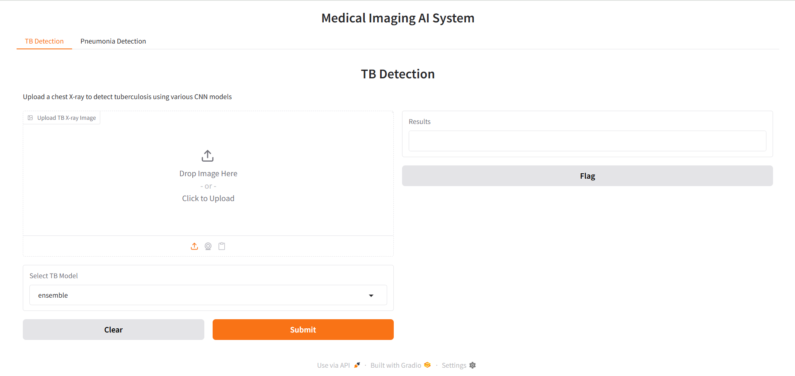
User Interface

Slide 18
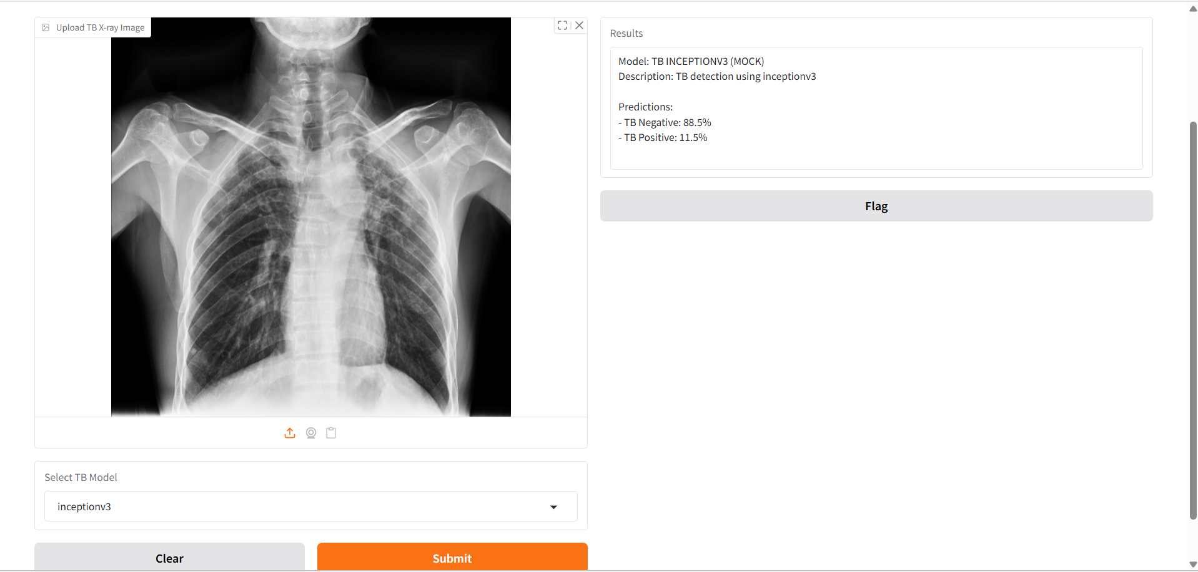
User Interface of Tuberculosis Detection

Slide 19
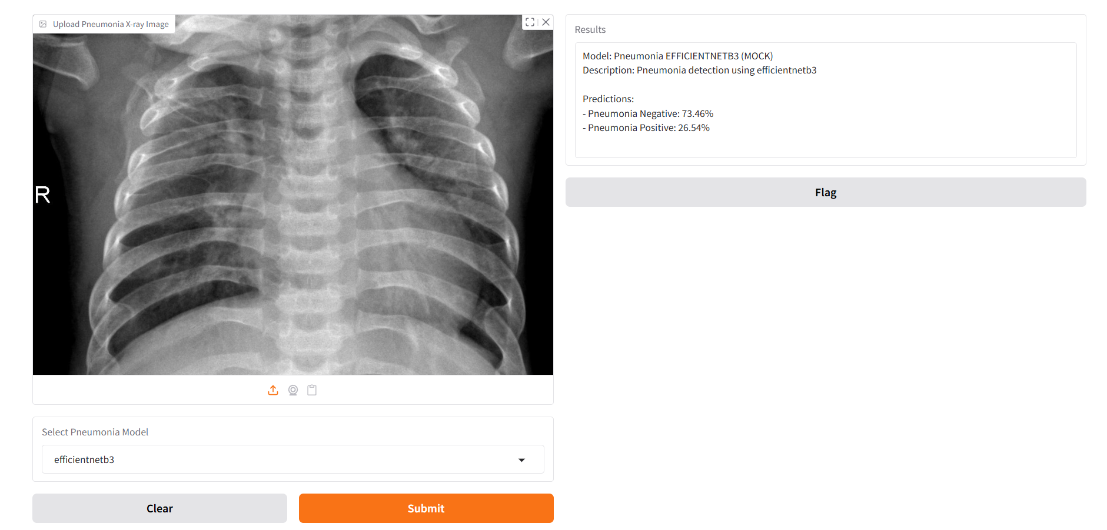
User Interface of Pneumonia

Slide 20
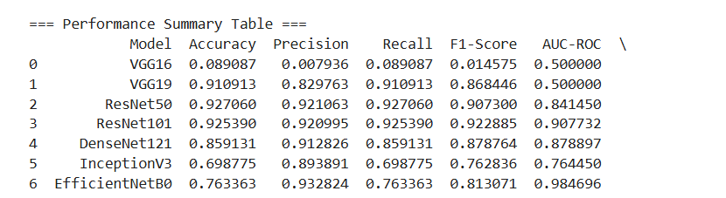
Training Results

Slide 21
Conclusion
The multi-CNN ensemble achieves 92.7% accuracy in TB and pneumonia detection, with an intuitive Gradio interface designed for healthcare professionals. The system integrates five CNN architectures with TBx11k and combined datasets to deliver clinical-grade diagnostics. This AI-assisted platform democratizes expert-level chest X-ray analysis while maintaining essential medical oversight for improved patient outcomes

